Slide 1

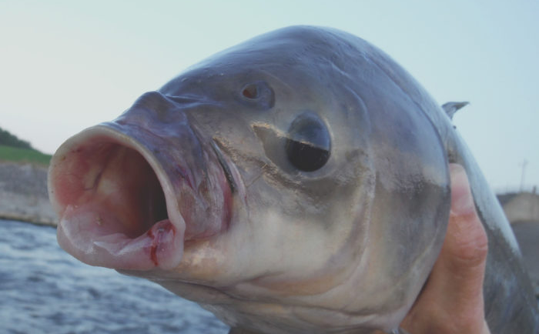
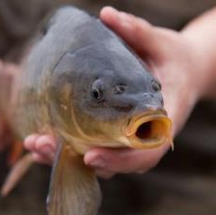
Modeling factors that affect carp and buffalo electrofishing catchability
Marty Simonson
ISU Department of Natural Resource Ecology and Management

Slide 2
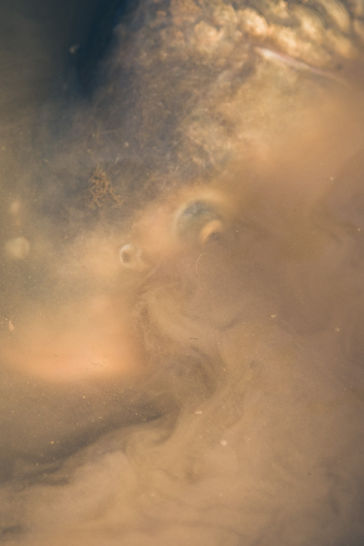
“Rough” Fish
Generally considered a nuisance
Increase turbidity through resuspension of sediments
Impacts nutrient levels, macrophyte growth, wildlife
Frustrates anglers and non-anglers

Slide 3
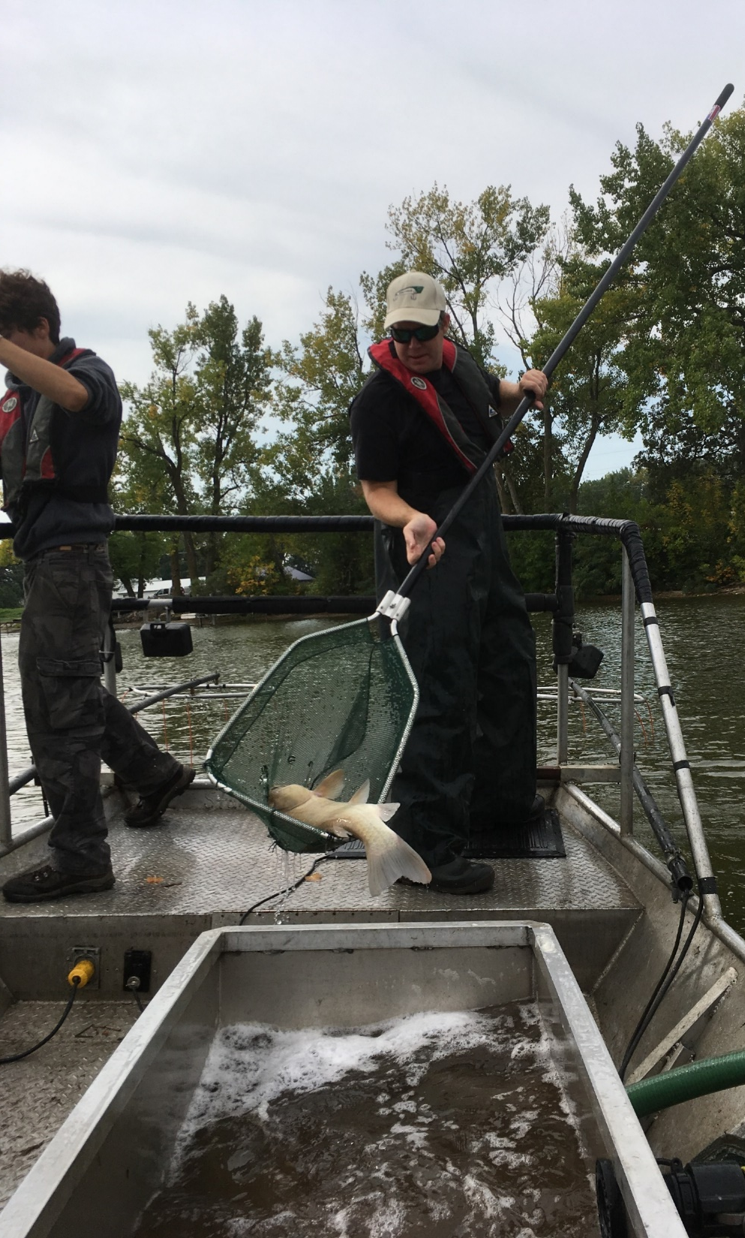
Sampling Fish Populations
Electrofishing:
-Commonly used for game and non-game species
-use of electricity to temporarily stun fish
Catch per unit effort (CPUE):
-IF CPUE is directly proportional to population size, relative abundance can be estimated
-Among taxa
-Within taxa among years

Slide 4
Study Sites
220 acres to 3,000 acres
Mean depth 5’ to 15’
Different shoreline complexities
i.e., Round vs. Elongated
Different biomass densities of carp and buffalo
Assumed constant within each lake and within each year
Repeated electrofishing runs generate >10 daily CPUE sample events per lake per year

Slide 5
Catchability and Catch-per-Unit-Effort functions
Catchability may vary as a function of:
-water temp (metabolism)
-shoreline complexity
-lake size and depth (amount of littoral area)
Foundational Equation:
CPUE = q * (abundance)
*q = catchability coefficient*

Slide 6
Catchability and Catch-per-Unit-Effort functions
Catchability may vary as a function of:
-water temp (metabolism)
-shoreline complexity
-lake size and depth (amount of littoral area)
Foundational Equation:
CPUE = q * (abundance)
*q = catchability coefficient*
CPUE / q = (abundance)
The IA DNR wants this:
Prediction of mass/area from CPUE and q

Slide 7
Catchability and Catch-per-Unit-Effort functions
Catchability may vary as a function of:
-water temp (metabolism)
-shoreline complexity
-lake size and depth (amount of littoral area)
Foundational Equation:
CPUE = q * (abundance)
*q = catchability coefficient*
CPUE / q = (abundance)
The IA DNR wants this:
Prediction of mass/area from CPUE and q
CPUE / (abundance) = q
This is the data we have, and
we want to model distribution for q

Slide 8
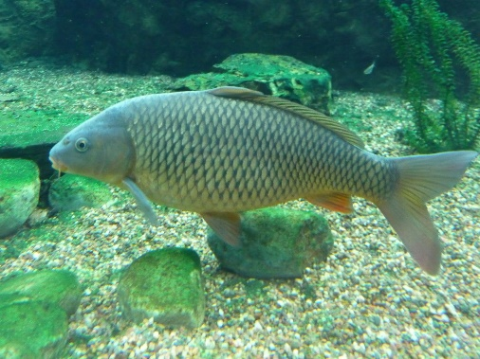
Objective
We want to model a distribution of q, the catchability coefficient.
Catchability is a latent, unknown variable
We hypothesize that catchability may vary as a function of 5 variables:
Water Temperature
Lake Size (hectares)
Lake Depth (meters; both maximum and mean)
Shoreline Development Index (1.0 = perfect circle, increases as lakes are elongated/sinuous)
Only temperature varies within a lake/year. The depth and shoreline factors vary among lakes but are constant within a lake and from year to year.
We have independent data sets:
CPUE data (# of fish per hour electroshocking)
Capture-Mark-Recapture data (abundance estimates, which we can transform to biomass density (kg/hectare))

Slide 9
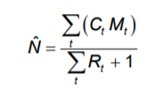
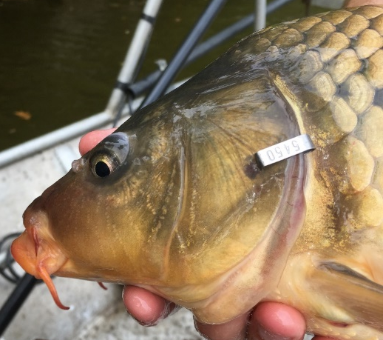
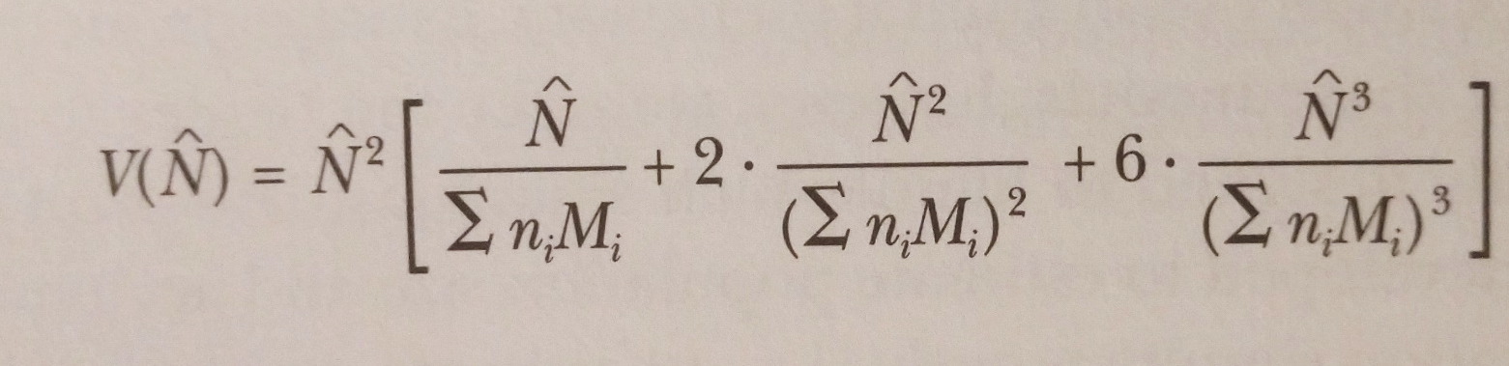
Estimating population size
Ct = ni = Total # fish caught in sample t
Mt = # marked in pop. just before t sample taken
Rt = # marked in sample t
Mark-Recapture
-Electrofishing
-STANDARD RUNS
-Individually numbered tags
-Marking on all occasions
-Multiple recapture events
Schnabel population estimate
-Extension of the Lincoln-Peterson
-Associated observational error
-Independent from CPUE data
Biomass Density
-Length-Specific Weight applied to N-hat
-Includes observational error

Slide 10
Example:
One Species
One Lake
One Year
Expected value:
Observed Data:
Unknown Distribution:
Observation error
Schnabel pop est.
Observation error
Pop size (N-hat)
Length-specific weight
Abundance (N-hat)
Constant through sampling season
CPUE
CPUE
CPUE
1
2
i
LAKE-SPECIFIC VARIABLES
Unknown
Catchability
Mean Depth
i
Water Temp.
i
SAMPLE-SPECIFIC VARIABLE
Max Depth
SAMPLE-SPECIFIC VARIABLE
Lake Size
Shoreline Index

Slide 11
Moving into R and JAGS
Open “Bayes CPUE.R”
Open “FirstAttempt.bug” -- use notepad
Front Matter
Examine model in .bug file
Run models
Examine output of betas
Examine posterior distribution of CPUE vs. Observed CPUE

